Slide 1
Welcome to
Math & Logic!

Slide 2
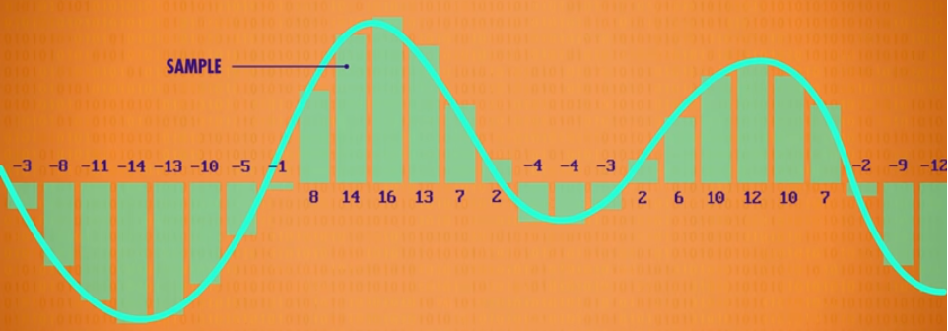
Review: What did we do in class last time?
Preview: How many negative and non-negative integers can we store in 8 bits?
Notes:
Review: Test 3 sound from Crash Course, positive and negative integers
Preview: We can store 256 numbers in 8 bits. If we use the first bit for the sign bit, we can store 128 numbers in 7 bits. Let’s store 128 non-negative numbers and 128 negative numbers using 8 bits.

Slide 3
Number Systems
Competency: Convert between place value number systems
2’s Complement Storage Scheme for Integers
2’s Complement Addition

Slide 4
Integers and
2’s Complement
Computers are binary machines. All data must be stored in a binary format.

Slide 5
Integers and
2’s Complement
Earlier, in mathematics, we studied different sets of numbers: N, W, Z, Q, I, and R.
Now, in computer science, we will call numbers that include a decimal point real numbers or floating point numbers and numbers that do not include a decimal point integers.

Slide 6
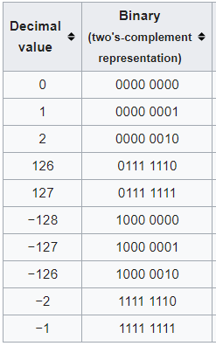
Integers and
2’s Complement
What do you notice about non-negative integers?
What do you notice about
negative integers?
https://en.wikipedia.org/wiki/Two%27s_complement
Notes:
The leftmost bit acts as a sign bit, 1 for negative, 0 for non-negative.

Slide 7
Integers and
2’s Complement
The 2’s complement form of a number has a sign bit built in; 0 for non-negative and 1 for negative.
In this lesson we will assume that one byte (8 bits) is available to store an integer.

Slide 8
Integers and
2’s Complement
Non-negative numbers are stored in normal binary form.
Negative numbers are stored in 2’s complement form.
2’s complement is used to store integers and for addition of integers.

Slide 9
Integers and
2’s Complement
93
Notes:
0101 1101
In 2’s Complement, non-negative numbers are stored in regular binary format. Non-negative numbers begin with 0.

Slide 10

Integers and
2’s Complement
-27
One method for writing negative integers in 2’s complement form in 8 bits is to start with -128 then add positive place values until you get to the desired negative integer. Another method is to write the positive value, flip the bits, and add 1. A third method is also shown.
Notes:
1110 0101 Negative numbers stored in 2’s complement format begin with 1. Check by changing Binary type to “signed 8-bit” at https://www.mathsisfun.com/binary-decimal-hexadecimal-converter.html

Slide 11
Integers and
2’s Complement Addition
59 + 50
Notes:
0011 1011 + 0011 0010 = 0110 1101
Both are positive numbers. Represent each number in 8 bits. Add. Check your answer.

Slide 12
Integers and
2’s Complement Addition
65 - 15 = 65 + -15
Adjust playback speed
Notes:
Subtraction is adding the inverse. Represent each number in 2’s Complement format. Add. Check the answer. Ignore overflow.
0100 0001 + 1111 0001 = 0011 0010

Slide 13
Integers and
2’s Complement Addition
-74 + -17
35 + -10
35 + -45
Right-click, Save video as. Open file, Start at time 15:15. Adjust playback speed with top menu
Notes:
1011 0110 + 1110 1111 = 1010 0101
0010 0011 + 1111 0110 = 0001 1001
0010 0011 + 1101 0011 = 1111 0110
Ignore overflow.

Slide 14
Integers and
2’s Complement Addition
Let’s practice now!
Notes:
Practice: Integers and 2’s Complement Addition

Slide 15
Review
2’s Complement Storage Scheme for Integers
2’s Complement Addition

Slide 16
To Do:
Test 3
Integer Quiz
Crash Course 13
Crash Course 14
Notes:
We made it to the midpoint of the term! Half done, half to go!

Slide 17
Have a great day!
And remember that every day
at CVTC is a great day!

